Slide 1

Healthy Habits
SLEEP, HYDRATION, EXERCISE & DIET
Presented by Anne-Marie Doran www.amellacoaching.com
www.farmwellhub.ie
Notes:
Our focus Today is understanding how the brain functions, the impact of sleep on health, and practical strategies for improving sleep quality.

Slide 2
How’s Your SHED
Sleep
Hydration
Exercise
Diet
www.farmwellhub.ie
Notes:
Sleep is one of the health pillars that contributes to our overall health and well being. Long term sleep deprivation goes alot further than having a bad day at the farm and I am here today to start the conversation and highlight the effects on under-slept people, give some practical take aways and if you are that person who is on the lower end of sleep a deeper understanding of why we should make sleep a priority

Slide 3

How’s Your Head
Sleep
Hydration
Exercise
Diet
www.farmwellhub.ie
Notes:
Were also going to chat about how our brain functions and how our SHED pilars effect our brain and visa versa

Slide 4



Slide 5

WHY IS SLEEP IMPORTANT
  CLEAR OUR THOUGHTS
  CLEAR TOXINS (DISEASE FORMING)
  REPLENSIH HORMONES
  satiating Hormone, growth hormone
  SKIN, BONE AND ORGAN HEALTH distribute vitimans & minerals
Notes:
Alot happens when we sleep. We clear our thoughts, toxins (disease forming) from the body and replensih hormones
satiating hormane, sex, growth hormone, energy levels, skin health

Slide 6

EFFECTS OF POOR SLEEP
FATIGUE, IRRITABILITY, LACK OF CONCENTRATION
INCREASED STRESS LEVELS, WEIGHT GAIN, HIGHER RISK OF ACCIDENTS.
HIGHER RISK OF CHRONIC DISEASE & MENTAL HEALTH ISSUES,
Notes:
Inability to engage human/ logic brain

Slide 7
UNDERSTANDING POOR SLEEP
SLEEP HYGIENE
IRREGULAR SLEEP PATTERNS
SCREEN EXPOSURE
CAFFINE & POOR DIET
MEDICAL CONDITION
SLEEP APNEA
RESTLESS LEG SYNDROME
INSOMNA

Slide 8

PRACTICAL STRATEGIES FOR BETTER SLEEP AT HOME
  AIM FOR 7-9 HOURS
  QUANTITY AND TIMING FOR CAFFINE NB
  AVOID SUGARY FOODS LATER AT NIGHT
  INCOPORATE SHED PILARS (HYDRATION, EXERCISE & DIET)
  GO TO BED AND WAKE UP AT THE SAME TIME EVERY DAY.
  AVOID SCREENS FOR AT LEAST AN HOUR BEFORE BED.
  KEEP YOUR ROOM COOL AND DARK: CREATE AN IDEAL SLEEPING ENVIRONMENT.

Slide 9

Hydration

Slide 10

Importance of Hydration:
  Energy and reduces tiredness.
  Aim for around 2 liters of water per day
  Spread Out Intake:
  Limit Sugary Beverages: Cause of energy spikes and dips.

Slide 11

Exercise
  Releases“feel-good” hormones
  Find enjoyment
  Consistency over intensity
  Variety and social engagement

Slide 12

Diet

Slide 13
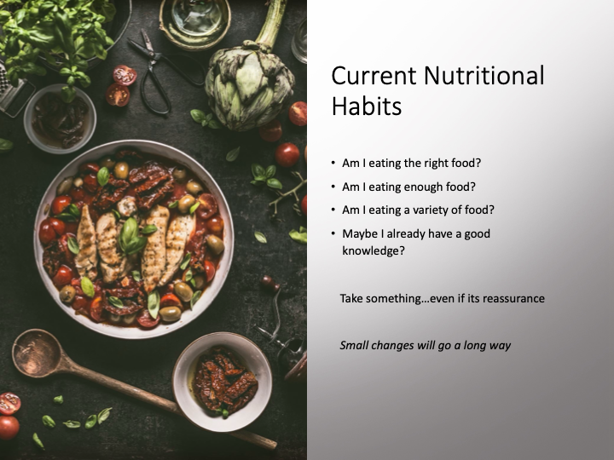

Slide 14
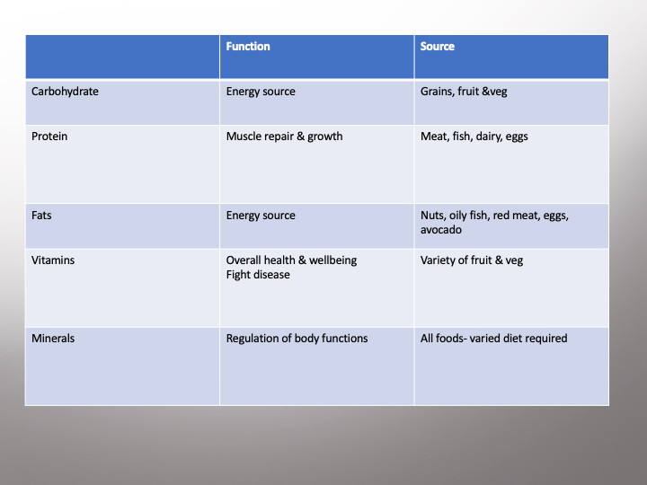

Slide 15

Some healthy carbohydrates
•Brown rice
•Oats
•Legumes
•Whole grain bread, pasta, cereal
•Fruit
•Vegetables
•Potatoes
•Pop corn

Slide 16

Healthy Fats
•Eggs
•Nuts
•Seeds
•Avocado
•Oily fish- salmon, mackerel, trout
•Red meat
•Cheese
•Olive oil

Slide 17

Protein
•Meet
•Fish
•Milk
•Cheese
•Eggs
•Yogurt
•Lentils
•Beans
•Tofu
•Chickpeas
•Protein products

Slide 18

Simplify Nutrition
Fruit & veg, protein healthy fat & carbohydrate in every meal
Ask what can I add to my diet
Think colours of the rainbow
Variety is the spice of life
Colours= variety= vitamins= health
Fruit & veg, protein healthy fat & carbohydrate in every meal
Ask what can I add to my diet
Think colours of the
Variety is the spice of life
Colours= variety= vitamins= health

Slide 19
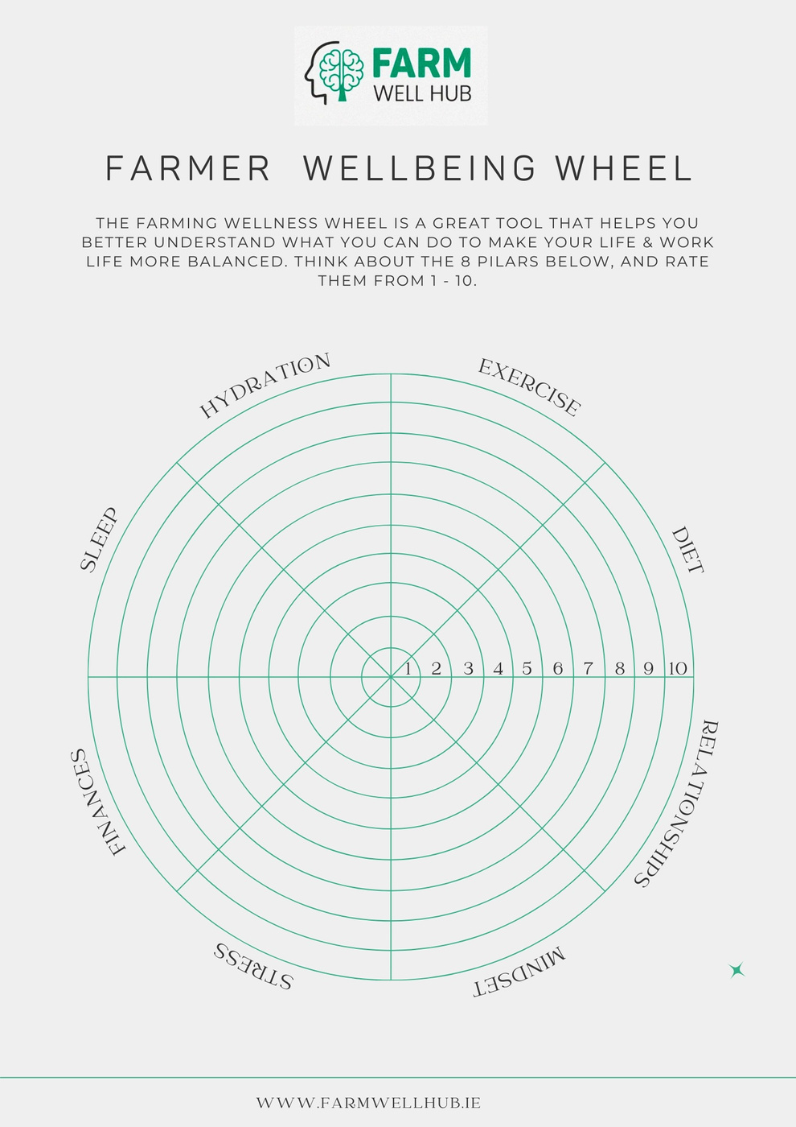

Slide 20
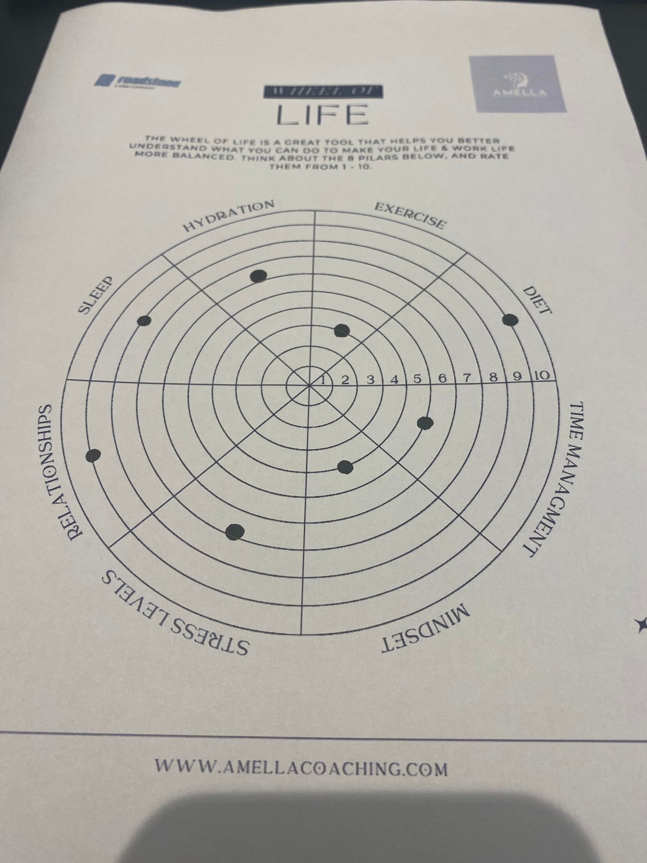

Slide 21
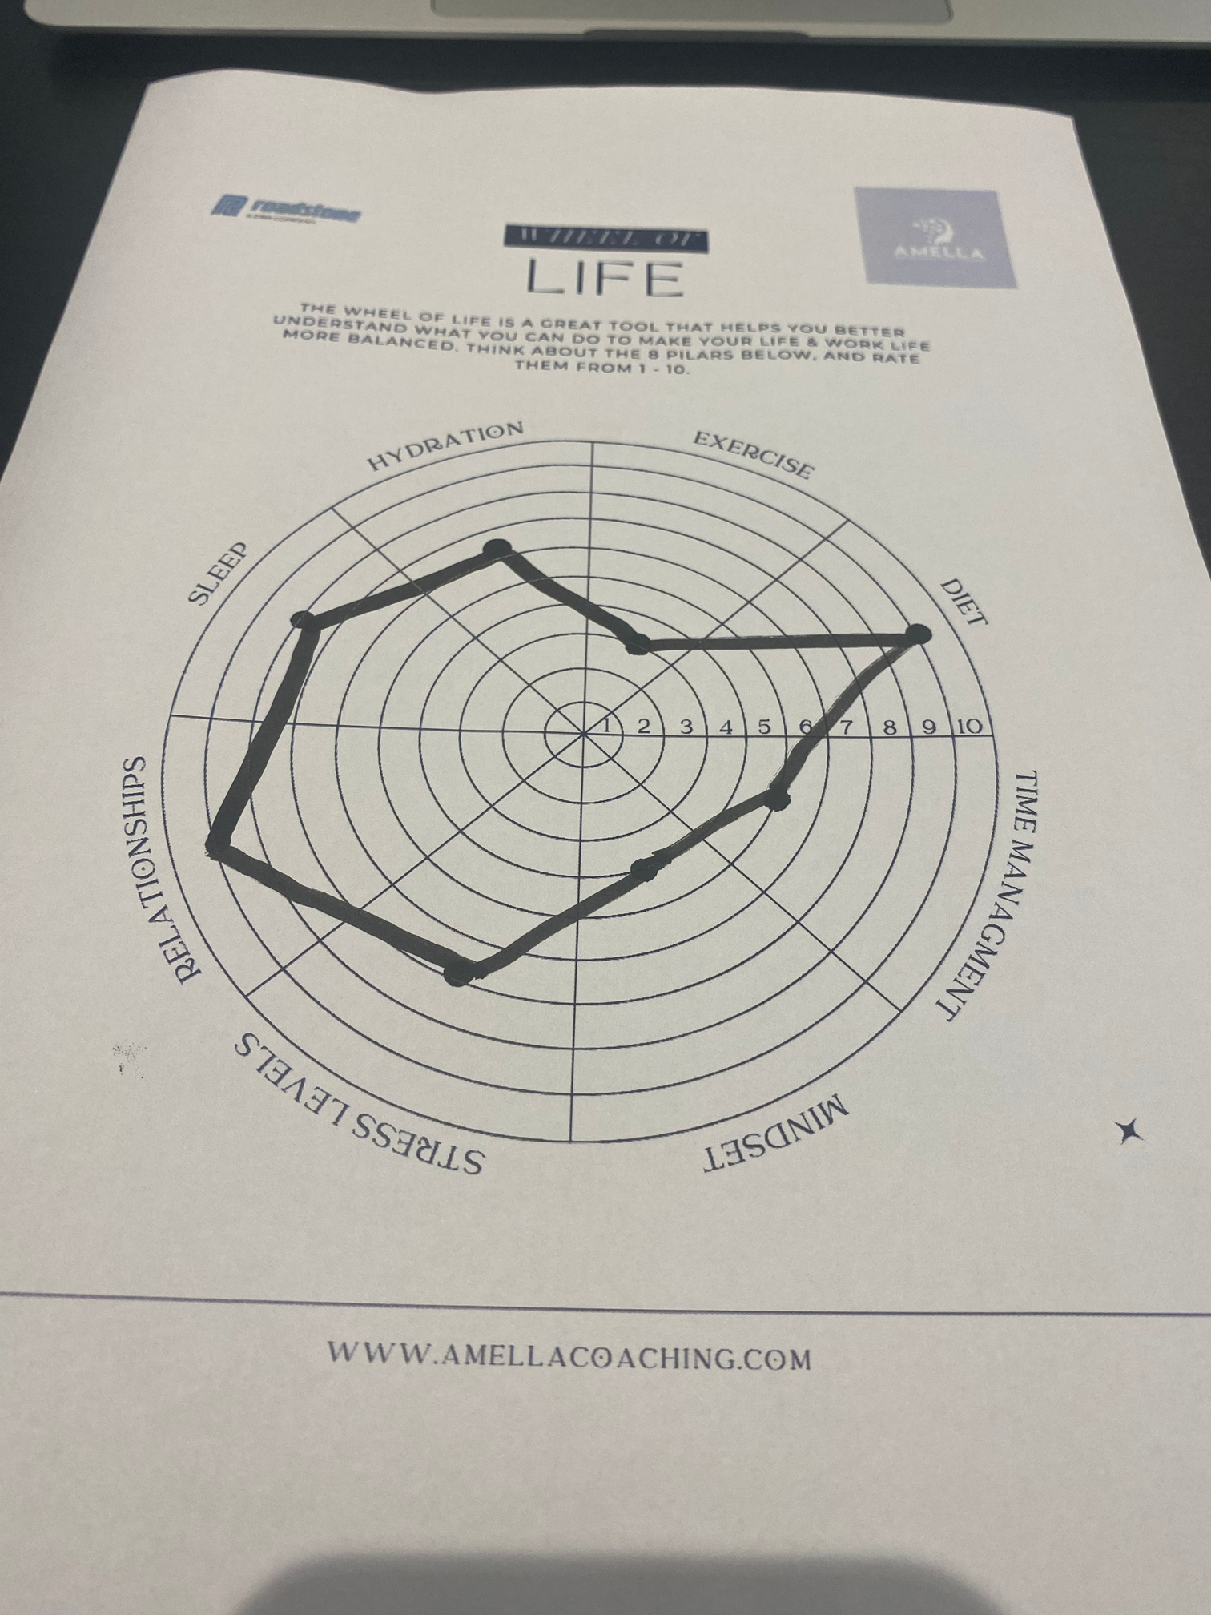

Slide 22
PILARS OF WELLBEING
  Sleep
  Hydration
  Exercise
  Diet
  Finances
  Mindset
  Stress Levels
  Relationships
WWW.FARMWELLHUB.IE

Slide 23
FOOD FOR THOUGHT
What am I going to do to improve my wellbeing today
WWW.FARMWELLHUB.IE

